Slide 1
What we will learn today?
Introduction to object recognition
A simple Object Recognition pipeline
Bag-of-words image representation
K-nearest neighbor algorithm

Slide 2
What we will learn today?
Introduction to object recognition
A simple Object Recognition pipeline
Bag-of-words image representation
K-nearest neighbor algorithm

Slide 3
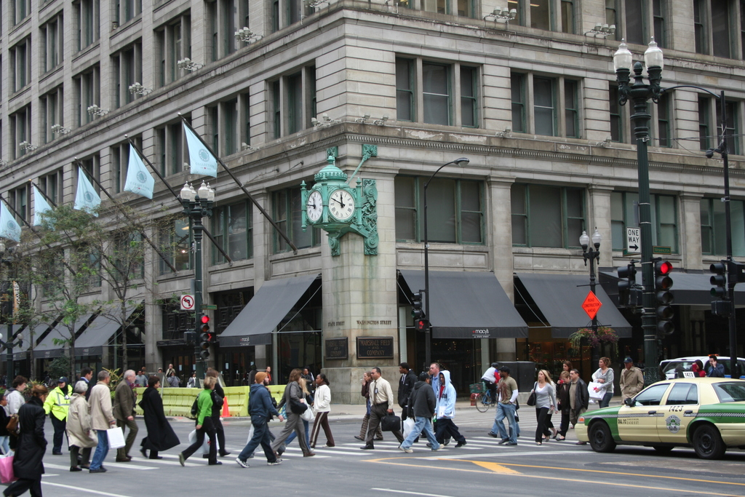
What are the different visual recognition tasks?
Notes:
Let’s give a look at this picture. It’s very easy for use to recognize the content of this picture. This is an urban scene. There is a building, a car, pedestrians and a clock. It would be great if we could design an artificial visual system that mimic human capabilities.
Specifically, what are the tasks we would like such a system to perform?

Slide 4
Classification:
Does this image contain a building? [yes/no]
Yes!

Slide 5
Classification:
Is this an beach?

Slide 6
Detection:
Does this image contain a car? [where?]
car

Slide 7
Detection:
Which object does this image contain? [where?]
Building
clock
person
car

Slide 8
Detection:
Accurate localization (segmentation)
clock

Slide 9
Detection: Estimating object semantic & geometric attributes
Object: Building, 45º pose,
8-10 meters away
It has bricks
Object: Person, back;
1-2 meters away
Object: Police car, side view, 4-5 m away
Notes:
If we have an autonomouse vehicle, we would need to recognize that is object is a building, estimate its pose: 45 degree, 5-6 meters away, we would need to tell that this car is the the police car, 2-3 meters away, that is waiting for the traffic light to become green., that there are people on the street; these people are infact crossing the street.

Slide 10
Categorization vs Single instance recognition
Does this image contain the Chicago Macy’s building?

Slide 11
Activity or Event recognition
What are these people doing?
Notes:
this device can perform 3D image recording of a face and use it as a password in protected enty points.
The system could be employed at airports or border crossings where a 3-D security camera could scan passengers' faces and compare them with a database of three-dimensional pictures of suspected criminals or terrorists, the twins said.

Slide 12
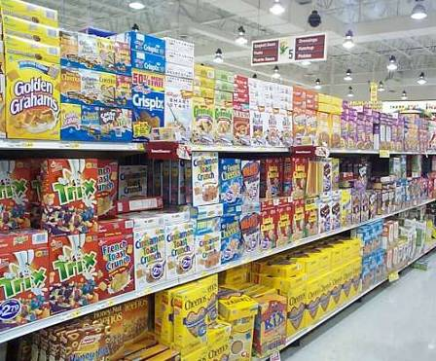
Categorization vs Single instance recognition
Where is the crunchy nut?

Slide 13

Image Search

Slide 14
Image Search
Organizing photo collections

Slide 15
Visual Recognition
Design algorithms that have the capability to:
Classify images or videos
Detect and localize objects
Estimate semantic and geometrical attributes
Classify human activities and events
Why is this challenging?

Slide 16
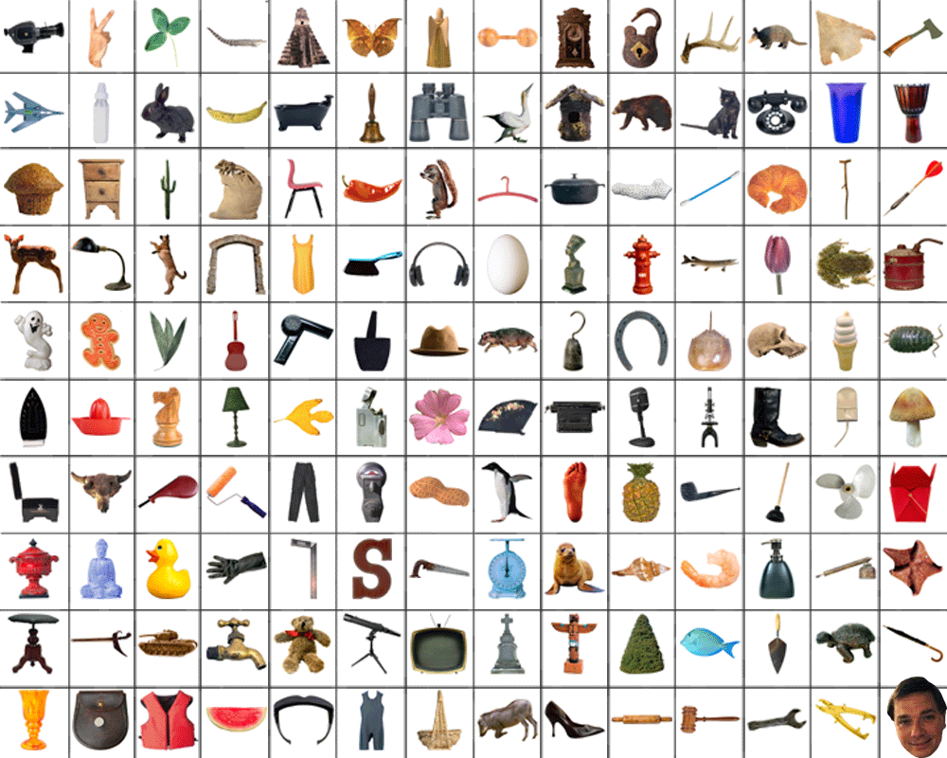
How many object categories are there?
~10,000 to 30,000

Slide 17
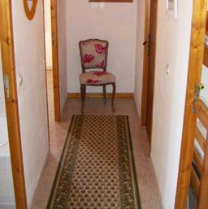

Object recognition Is it really so hard?
Find the chair in this image
Output of normalized correlation
This is a chair

Slide 18
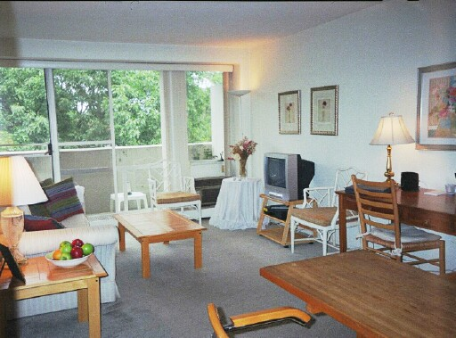

Object recognition Is it really so hard?
Find the chair in this image
Pretty much garbage
Simple template matching is not going to make it
A “popular method is that of template matching, by point to point correlation of a model pattern with the image pattern. These techniques are inadequate for three-dimensional scene analysis for many reasons, such as occlusion, changes in viewing angle, and articulation of parts.” Nivatia & Binford, 1977.

Slide 19
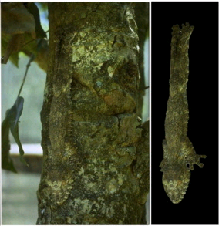
And it can get a lot harder
Brady, M. J., & Kersten, D. (2003). Bootstrapped learning of novel objects. J Vis, 3(6), 413-422

Slide 20
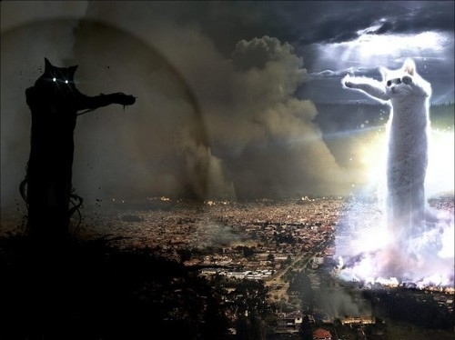
Challenges: Illumination

Slide 21



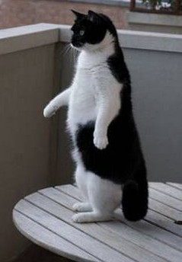
Challenges: Deformation

Slide 22

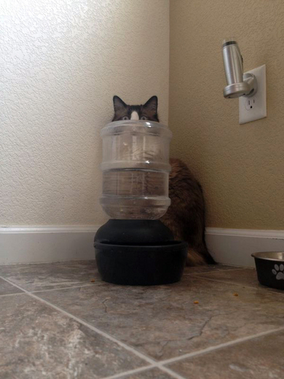
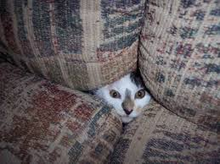
Challenges: Occlusion

Slide 23
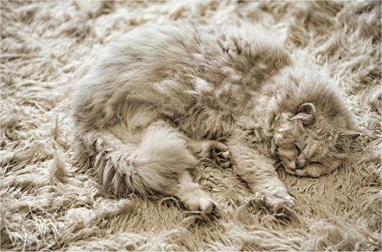
Challenges: Background clutter

Slide 24
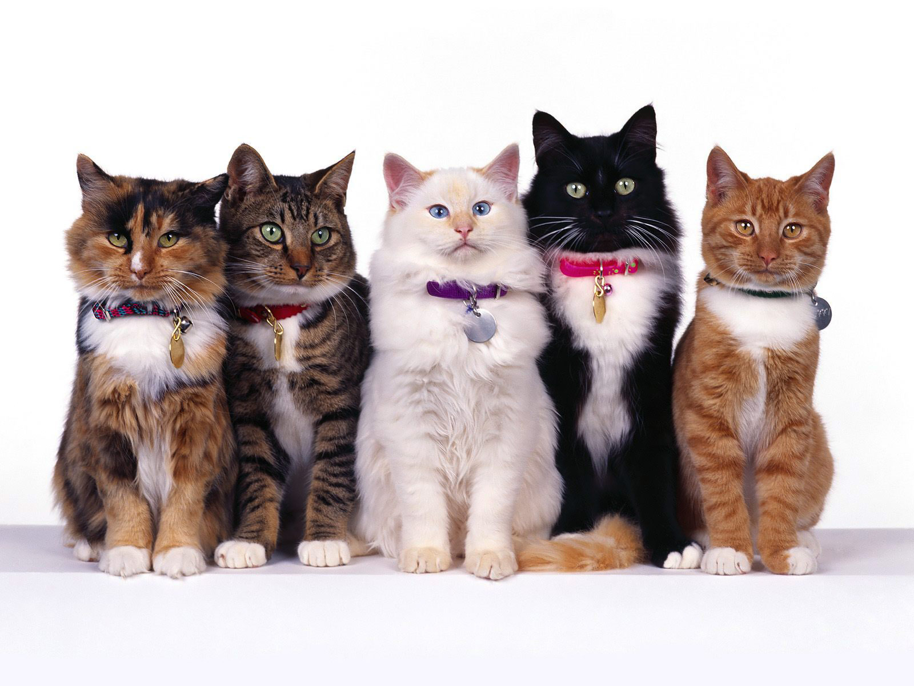
Challenges: Intraclass variation

Slide 25
What we will learn today?
Introduction
A simple Object Recognition pipeline
Bag-of-words image representation
K-nearest neighbor algorithm

Slide 26
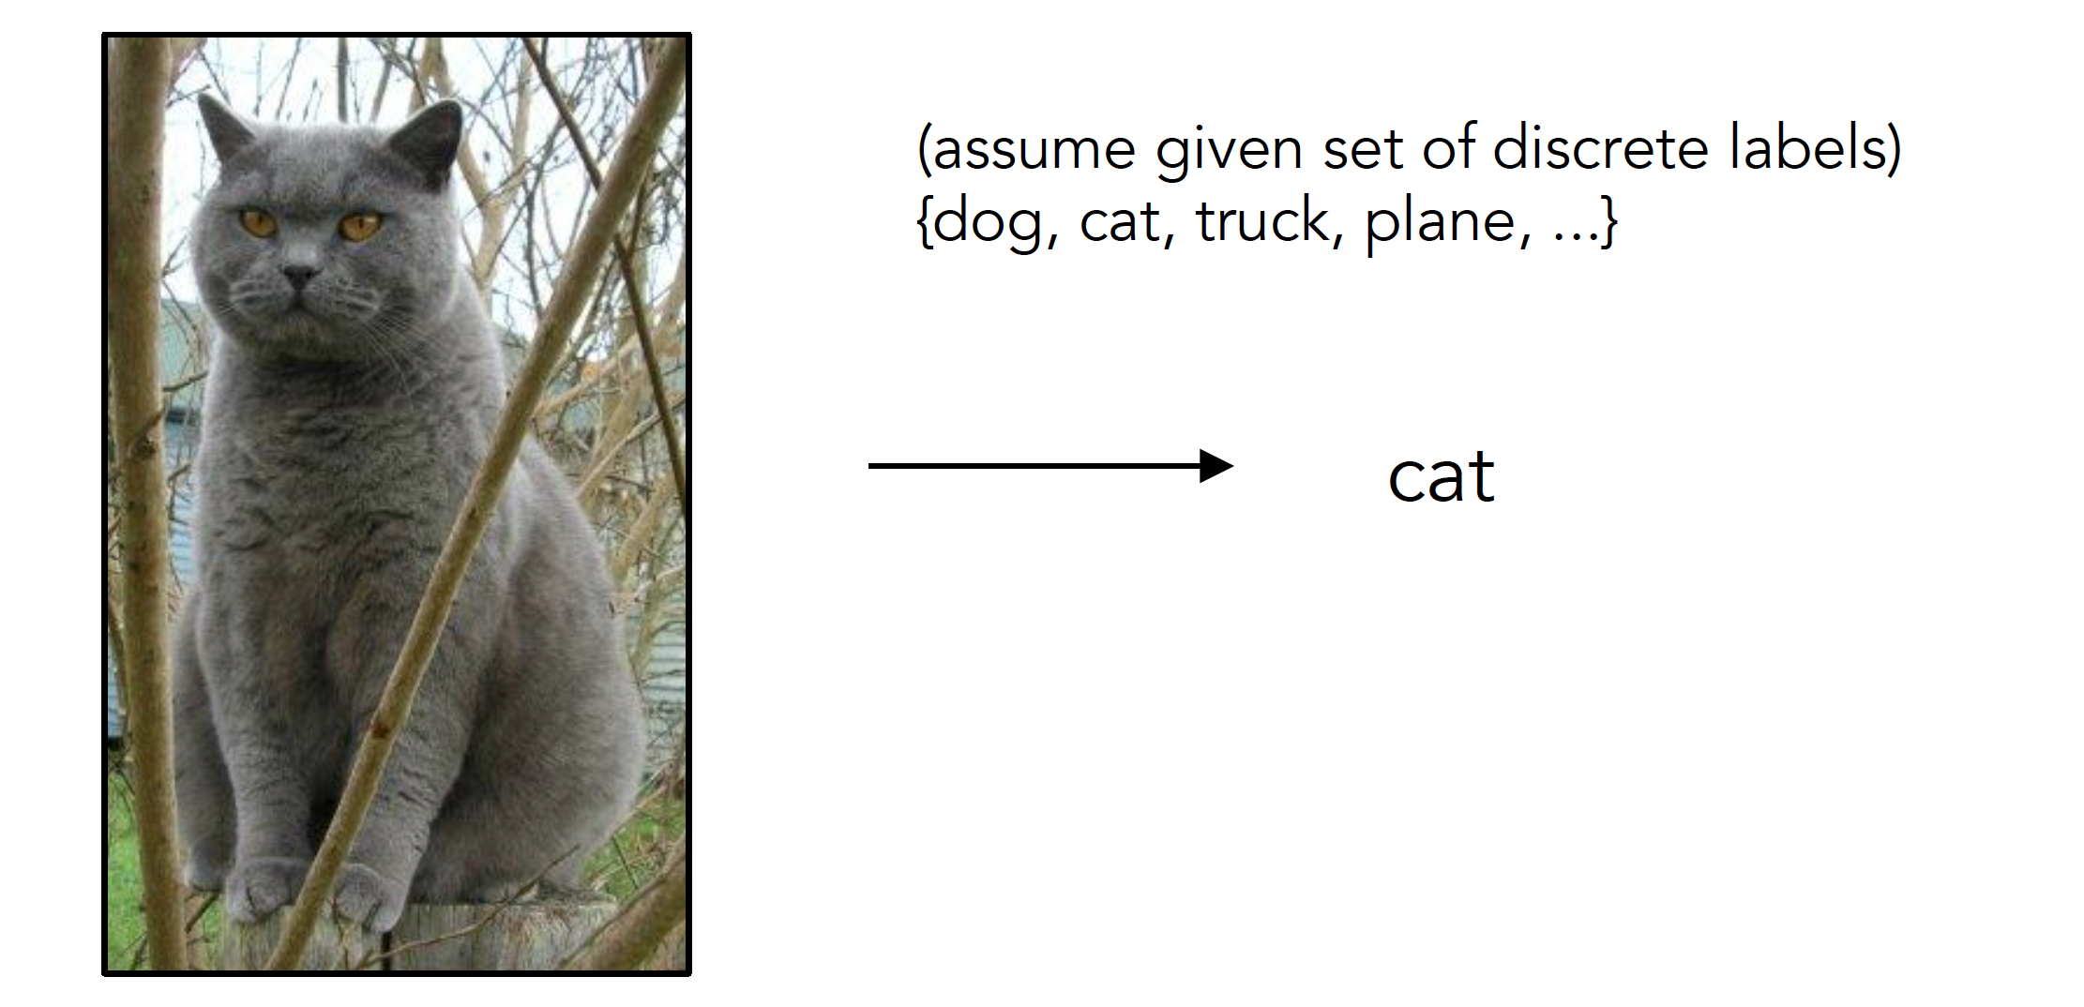
Image Classification

Slide 27

Image Classification: Problem

Slide 28
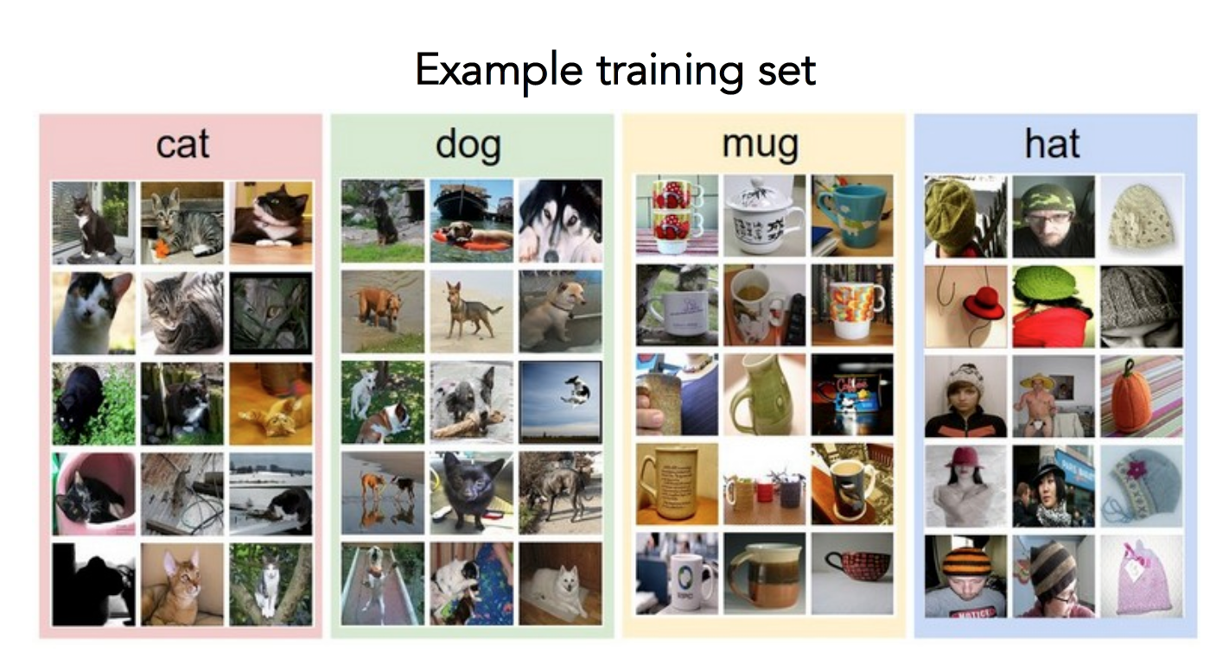
Data-driven approach
Collect a database of images with labels
Use ML to train an image classifier
Evaluate the classifier on test images

Slide 29

Image classification

Slide 30
The machine learning framework
y = f(x)
Training: given a training set of labeled examples {(x₁,y₁), …, (x_{N},y_{N})}, estimate the prediction function f by minimizing the prediction error on the training set
Testing: apply f to a never before seen test example x and output the predicted value y = f(x)
output
prediction function
Image feature
Slide credit: L. Lazebnik

Slide 31
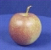
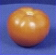
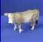
Object recognition: a classification framework
Apply a prediction function to a feature representation of the image to get the desired output:
f( ) = “apple”
f( ) = “tomato”
f( ) = “cow”
Dataset: ETH-80, by B. Leibe
Slide credit: L. Lazebnik

Slide 32
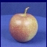
Steps
Training
Training Labels
Training Images
Image Features
Training
Learned model
Learned model
Testing
Image Features
Prediction
Test Image
Slide credit: D. Hoiem

Slide 33
Traditional recognition pipeline
Hand-designed feature extraction
Trainable classifier
Image
Pixels
Object Class
Features are not learned
Trainable classifier is often generic (e.g. SVM)

Slide 34
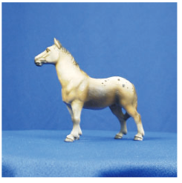
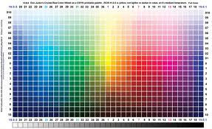
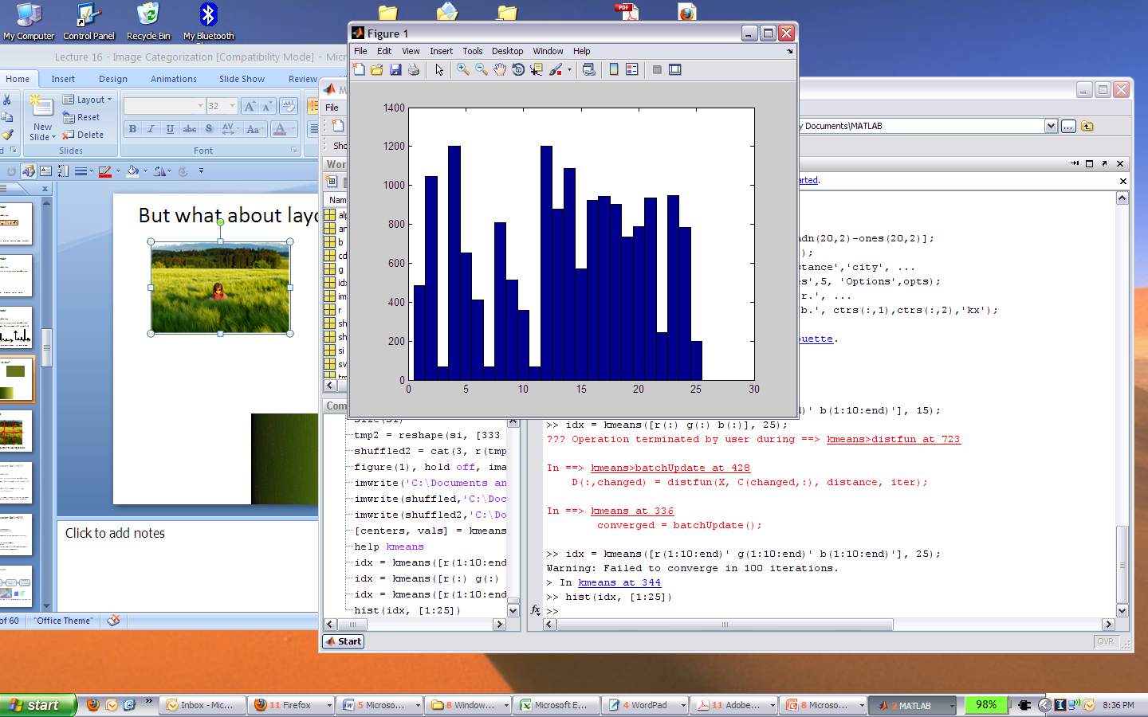
Image features
Input image
Color: Quantize RGB values
Invariance?
? Translation
? Scale
? Rotation
? Occlusion

Slide 35


Image features
Input image
Color: Quantize RGB values
Invariance?
? Translation
? Scale
? Rotation (in-planar)
? Occlusion

Slide 36

Image features
Input image
Global shape: PCA space
Invariance?
? Translation
? Scale
? Rotation (in-planar)
? Occlusion

Slide 37
Image features
Input image
Invariance?
? Translation
? Scale
? Rotation (in-planar)
? Occlusion
Global shape: PCA space

Slide 38
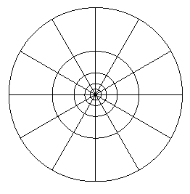
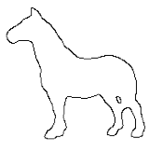
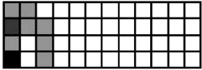
Image features
Input image
Local shape: shape context
Invariance?
? Translation
? Scale
? Rotation (in-planar)
? Occlusion

Slide 39
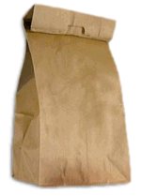
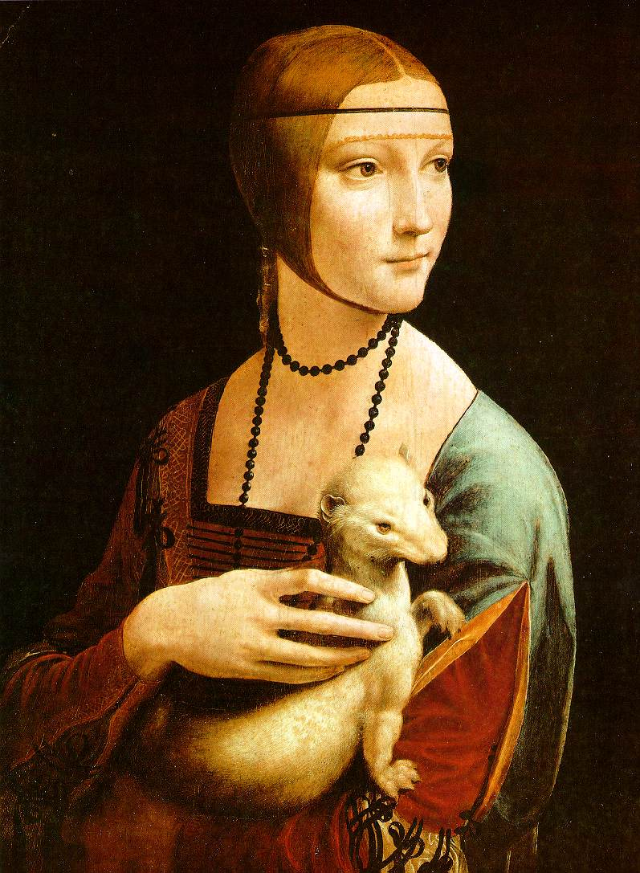
Bag of Words

Slide 40





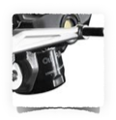
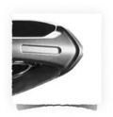


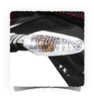

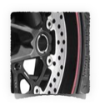


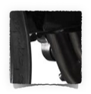
What object do these parts belong to?

Slide 41

Some local feature are very informative
An object as
a collection of local features
(bag-of-features)
deals well with occlusion
scale invariant
rotation invariant

Slide 42
(not so) crazy assumption
spatial information of local features
can be ignored for object recognition (i.e., verification)

Slide 43
Bag-of-features
represent a data item (document, texture, image)
as a histogram over features
an old idea
(e.g., texture recognition and information retrieval)

Slide 44




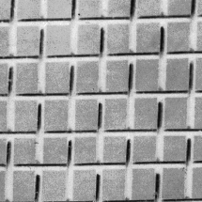
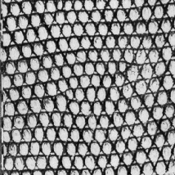
Texture recognition
histogram
Universal texton dictionary

Slide 45
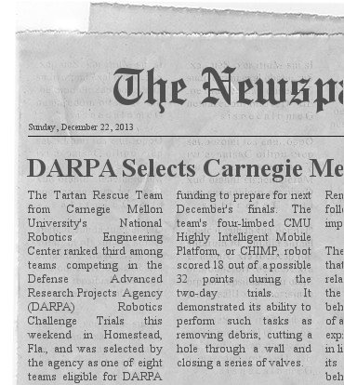
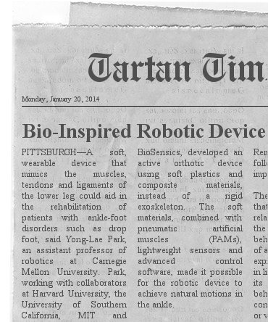
Vector Space Model
G. Salton. ‘Mathematics and Information Retrieval’ Journal of Documentation,1979
1 | 6 | 2 | 1 | 0 | 0 | 0 | 1
Tartan | robot | CHIMP | CMU | bio | soft | ankle | sensor
0 | 4 | 0 | 1 | 4 | 5 | 3 | 2
Tartan | robot | CHIMP | CMU | bio | soft | ankle | sensor
http://www.fodey.com/generators/newspaper/snippet.asp

Slide 46

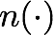
A document (datapoint) is a vector of counts over each word (feature)
counts the number of occurrences
just a histogram over words
What is the similarity between two documents?

Slide 47

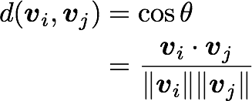
A document (datapoint) is a vector of counts over each word (feature)
counts the number of occurrences
just a histogram over words
What is the similarity between two documents?
Use any distance you want but the cosine distance is fast.

Slide 48
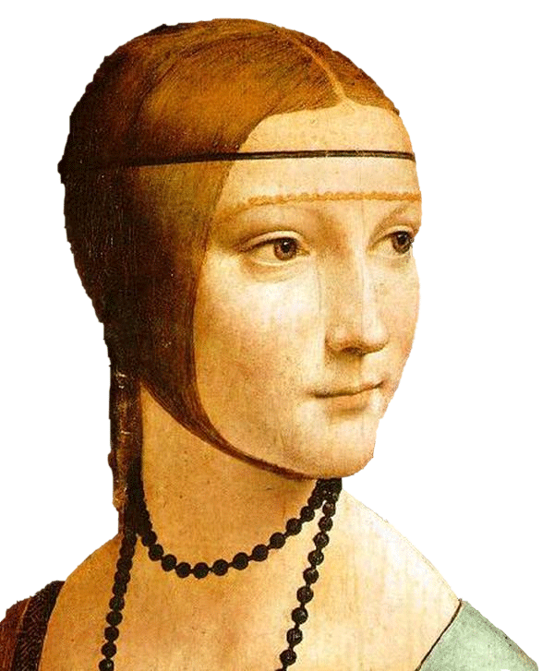
Object
Bag of ‘words’
ICCV 2005 short course, L. Fei-Fei

Slide 49
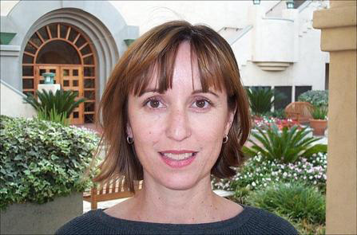
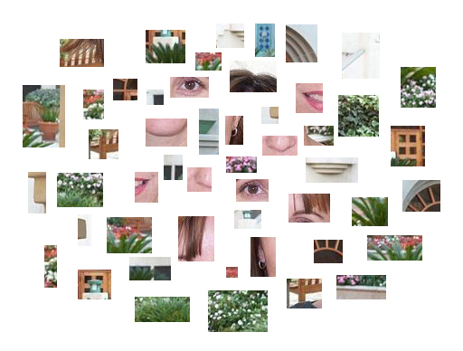
Bag of features for object recognition
face, flowers, building
Works pretty well for image-level classification and for recognizing object instances
Csurka et al. (2004), Willamowski et al. (2005), Grauman & Darrell (2005), Sivic et al. (2003, 2005)

Slide 50
Standard BoW pipeline
Dictionary Learning:
Learn Visual Words using clustering
Encode:
build Bags-of-Words (BOW) vectors
for each image
Classify:
Train and test data using BOWs

Slide 51
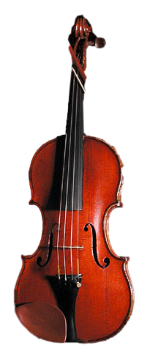
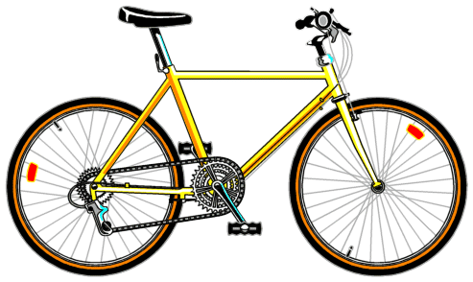
Notes:
51
CS 376 Lecture 18

Slide 52
Bag of features: outline
Extract features

Slide 53
Bag of features: outline
Extract features
Learn “visual vocabulary”

Slide 54
Bag of features: outline
Extract features
Learn “visual vocabulary”
Quantize features using visual vocabulary

Slide 55
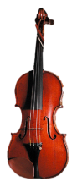
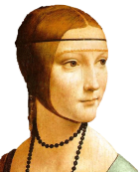
Bag of features: outline
Extract features
Learn “visual vocabulary”
Quantize features using visual vocabulary
Represent images by frequencies of “visual words”

Slide 56
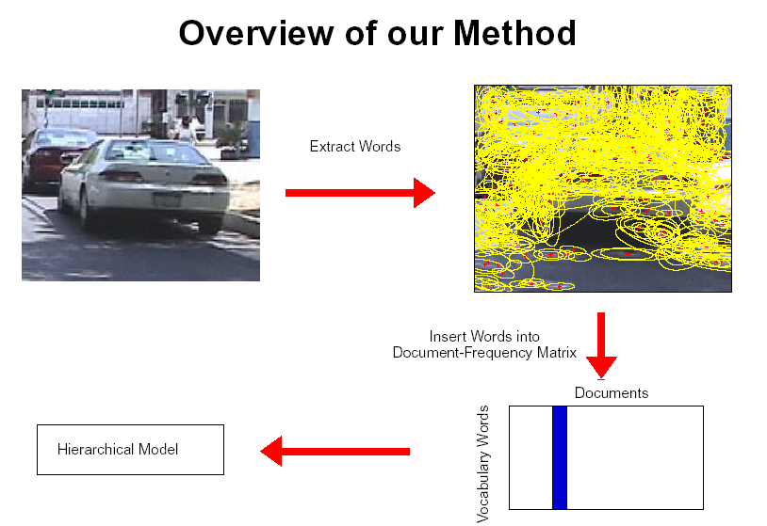
1. Feature extraction
Regular grid
Vogel & Schiele, 2003
Fei-Fei & Perona, 2005

Slide 57
1. Feature extraction
Regular grid
Vogel & Schiele, 2003
Fei-Fei & Perona, 2005
Interest point detector
Csurka et al. 2004
Fei-Fei & Perona, 2005
Sivic et al. 2005
Other methods
Random sampling (Vidal-Naquet & Ullman, 2002)
Segmentation-based patches (Barnard et al. 2003)

Slide 58
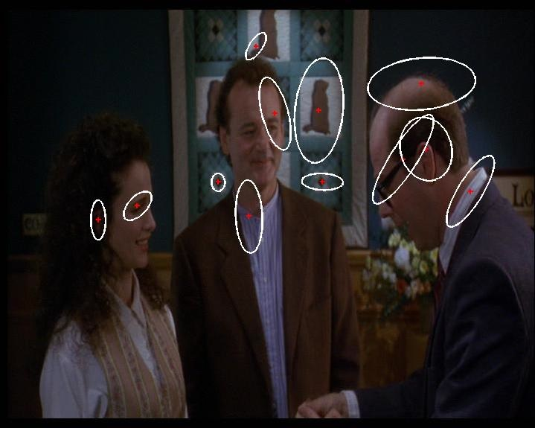
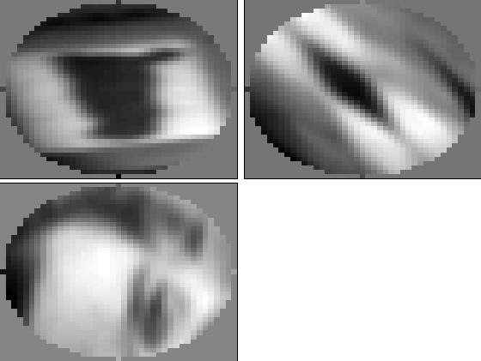
Compute SIFT descriptor
[Lowe’99]
Normalize patch
Detect patches
[Mikojaczyk and Schmid ’02]
[Mata, Chum, Urban & Pajdla, ’02]
[Sivic & Zisserman, ’03]

Slide 59
…

Slide 60
2. Learning the visual vocabulary
…

Slide 61
2. Learning the visual vocabulary
…
Clustering
Slide credit: Josef Sivic

Slide 62
2. Learning the visual vocabulary
Visual vocabulary
…
Clustering
Slide credit: Josef Sivic

Slide 63
K-means clustering
K-means is a partitional clustering algorithm
Let the set of data points (or instances) D be
{x₁, x₂, …, x_{n}},
where x_{i} = (x_{i1}, x_{i2}, …, x_{ir}) is a vector in a real-valued space X ⊆ R^{r}, and r is the number of attributes (dimensions) in the data.
The k-means algorithm partitions the given data into k clusters.
Each cluster has a cluster center, called centroid.
k is specified by the user

Slide 64
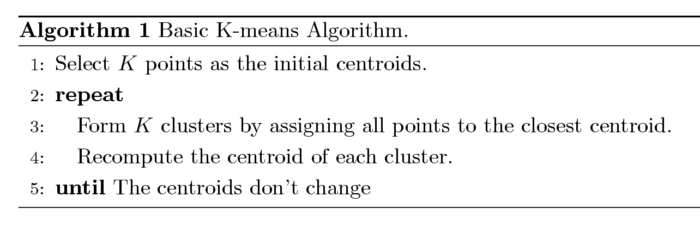
K-means Clustering
Basic algorithm

Slide 65
K-means Iterations

Slide 66
Seed Choice
K-means results can vary based on random seed selection.
Usually, k-means is run several times, and the clustering which minimizes the total sum of squared distances is chosen amongst the multiple clusterings
Notes:
66

Slide 67
Clustering and vector quantization
Clustering is a common method for learning a visual vocabulary or codebook
Each cluster center produced by k-means becomes a codevector
If the training set is representative enough, the codebook will be “universal”: will be able to represent most of the words
The codebook is used for quantizing features
A vector quantizer takes a feature vector and maps it to the index of the nearest codevector in a codebook
Codebook = visual vocabulary
Codevector = visual word
67
Notes:
67

Slide 68
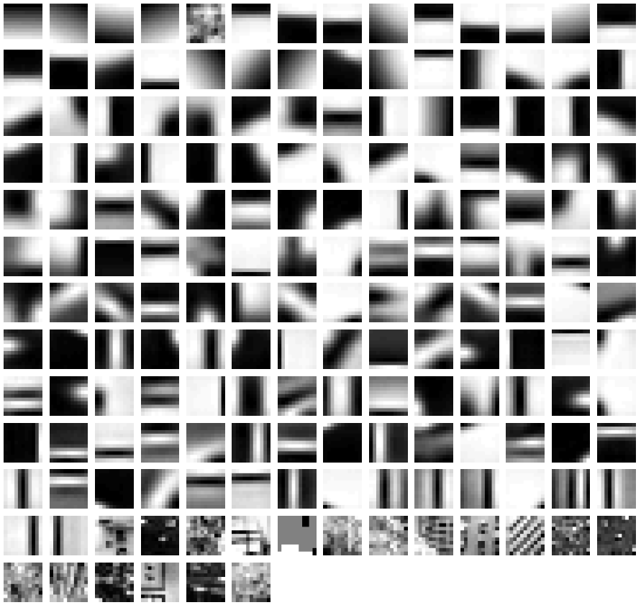
Example visual dictionary (visual vocabulary)
Fei-Fei et al.

Slide 69
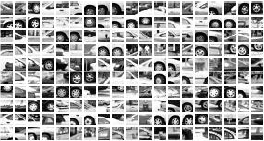
















Example dictionary
…
Appearance codebook
69
Source: B. Leibe
Notes:
69

Slide 70

Another dictionary
…
…
…
…
…
Appearance codebook
Source: B. Leibe

Slide 71


Encode:
build Bags-of-Words (BOW) vectors
for each image
2. Histogram: count the number of visual word occurrences

Slide 72
3. Image representation
frequency
…..
codewords

Slide 73
Image classification
Given the bag-of-features representations of images from different classes, how do we learn a model for distinguishing them?

Slide 74
The machine learning framework
y = f(x)
Training: given a training set of labeled examples {(x₁,y₁), …, (x_{N},y_{N})}, estimate the prediction function f by minimizing the prediction error on the training set
Testing: apply f to a never before seen test example x and output the predicted value y = f(x)
output
prediction function
Image feature
Slide credit: L. Lazebnik

Slide 75
Classification
Assign input vector to one of two or more classes
Any decision rule divides input space into decision regions separated by decision boundaries
Slide credit: L. Lazebnik

Slide 76
K nearest neighbors
Support Vector Machine
Naïve Bayes

Slide 77
What we will learn today?
Introduction
A simple Object Recognition pipeline
Bag-of-words image representation
K-nearest neighbor algorithm

Slide 78
Classifiers: Nearest neighbor
Test example
Training examples from class 2
Training examples from class 1
f(x) = label of the training example nearest to x
All we need is a distance function for our inputs
No training required!
Notes:
“Non-parametric” classifier: the entire training set is essentially the model parameters.
Pros:
Very fast at training time
Flexible: all it requires is a way to compute similarity or distances between pairs of features. Applies to many different kinds of features.
Works with any number of classes.
Works well in practice for large datasets (but see cons)
Cons:
Slow at test time (need to compute distances between test example and every training example)

Slide 79
K-nearest neighbor
Distance measure - Euclidean
x
x
x
o
x
x
x
+
o
o
x
x
o
o
Where X^{n} and X^{m} are the n-th and m-th data points
o
o
x2
x1

Slide 80
1-nearest neighbor
Distance measure - Euclidean
x
x
x
o
x
x
x
+
o
o
x
x
o
o
Where X^{n} and X^{m} are the n-th and m-th data points
o
o
x2
x1

Slide 81
3-nearest neighbor
Distance measure - Euclidean
x
x
x
o
x
x
x
+
o
o
x
x
o
o
Where X^{n} and X^{m} are the n-th and m-th data points
o
o
x2
x1

Slide 82
5-nearest neighbor
Distance measure - Euclidean
x
x
x
o
x
x
x
+
o
o
x
x
o
o
Where X^{n} and X^{m} are the n-th and m-th data points
o
o
x2
x1

Slide 83
K-NN: a very useful algorithm
Simple, a good one to try first
Very flexible decision boundaries

Slide 84
K-NN: issues to keep in mind
Choosing the value of k:
If too small, sensitive to noise points
If too large, neighborhood may include points from other classes

Slide 85


K-NN: issues to keep in mind
Choosing the value of k:
If too small, sensitive to noise points
If too large, neighborhood may include points from other classes
K=1
K=15

Slide 86

K-NN: issues to keep in mind
Choosing the value of k:
If too small, sensitive to noise points
If too large, neighborhood may include points from other classes
Solution: cross validate!

Slide 87
Cross validation

Slide 88
K-NN: issues to keep in mind
Choosing the value of k:
If too small, sensitive to noise points
If too large, neighborhood may include points from other classes
Solution: cross validate!
Can produce counter-intuitive results (using Euclidean measure)

Slide 89
Euclidean measure
1 1 1 1 1 1 1 1 1 1 1 0
1 0 0 0 0 0 0 0 0 0 0 0
vs
0 1 1 1 1 1 1 1 1 1 1 1
0 0 0 0 0 0 0 0 0 0 0 1
d = 1.4142
d = 1.4142

Slide 90
K-NN: issues to keep in mind
Choosing the value of k:
If too small, sensitive to noise points
If too large, neighborhood may include points from other classes
Solution: cross validate!
Can produce counter-intuitive results (using Euclidean measure)
Solution: normalize the vectors to unit length

Slide 91
K-NN: issues to keep in mind
Choosing the value of k:
If too small, sensitive to noise points
If too large, neighborhood may include points from other classes
Solution: cross validate!
Can produce counter-intuitive results (using Euclidean measure)
Solution: normalize the vectors to unit length
Curse of Dimensionality
Solution: no good one

Slide 92

K-nearest neighbor classifier
Which classifier is more robust to outliers?
Credit: Andrej Karpathy, http://cs231n.github.io/classification/

Slide 93

K-nearest neighbor classifier
Credit: Andrej Karpathy, http://cs231n.github.io/classification/

Slide 94
Functions for comparing histograms
L1 distance:
χ² distance:
Quadratic distance (cross-bin distance):
Histogram intersection (similarity function):

Slide 95
Many classifiers to choose from
K-nearest neighbor
SVM
Neural networks
Naïve Bayes
Bayesian network
Logistic regression
Randomized Forests
Boosted Decision Trees
RBMs
Etc.
Which is the best one?
Slide credit: D. Hoiem

Slide 96

Generalization
Generalization refers to the ability to correctly classify never before seen examples
Can be controlled by turning “knobs” that affect the complexity of the model
Training set (labels known)
Test set (labels unknown)

Slide 97
Diagnosing generalization ability
Training error: how does the model perform on the data on which it was trained?
Test error: how does it perform on never before seen data?
Underfitting
Overfitting
Error
Test error
Training error
Low
Model complexity
High
Source: D. Hoiem

Slide 98

Underfitting and overfitting
Underfitting: training and test error are both high
Model does an equally poor job on the training and the test set
Either the training procedure is ineffective or the model is too “simple” to represent the data
Overfitting: Training error is low but test error is high
Model fits irrelevant characteristics (noise) in the training data
Model is too complex or amount of training data is insufficient
Underfitting
Good generalization
Overfitting
Figure source

Slide 99
Effect of training set size
Few training examples
Test Error
Many training examples
Low
Model complexity
High
Source: D. Hoiem
Notes:
Note: these figures don’t work in pdf

Slide 100
Validation
Split the data into training, validation, and test subsets
Use training set to optimize model parameters
Use validation test to choose the best model
Use test set only to evaluate performance
Stopping point
Test set loss
Error
Validation
set loss
Training set loss
Model complexity

Slide 101
Last remarks about applying machine learning methods to object recognition
There are machine learning algorithms to choose from
Know your data:
How much supervision do you have?
How many training examples can you afford?
How noisy?
Know your goal (i.e. task):
Affects your choices of representation
Affects your choices of learning algorithms
Affects your choices of evaluation metrics
Understand the math behind each machine learning algorithm under consideration!

Slide 102
Uses of BoW representation
Treat as feature vector for standard classifier
e.g k-nearest neighbors, support vector machine
Cluster BoW vectors over image collection
Discover visual themes

Slide 103




Large-scale image matching
Bag-of-words models have been useful in matching an image to a large database of object instances
11,400 images of game covers
(Caltech games dataset)
how do I find this image in the database?

Slide 104
Large-scale image search
Build the database:
Extract features from the database images
Learn a vocabulary using k-means (typical k: 100,000)
Compute weights for each word
Create an inverted file mapping words to images

Slide 105
Bags of words: pros and cons
+ flexible to geometry / deformations / viewpoint
+ compact summary of image content
+ provides vector representation for sets
+ very good results in practice
basic model ignores geometry – must verify afterwards, or encode via features
background and foreground mixed when bag covers whole image
optimal vocabulary formation remains unclear
Notes:
105
105
CS 376 Lecture 18

Slide 106




What about spatial info?
?

Slide 107
Spatial Pyramids
Very useful for representing images.
Pyramid is built by using multiple copies of image.
Each level in the pyramid is 1/4 of the size of previous level.
The lowest level is of the highest resolution.
The highest level is of the lowest resolution.

Slide 108


Spatial pyramids
level 0
Lazebnik, Schmid & Ponce (CVPR 2006)

Slide 109




Spatial pyramids
level 0
level 1
Lazebnik, Schmid & Ponce (CVPR 2006)

Slide 110
















Spatial pyramids
level 0
level 1
level 2
Lazebnik, Schmid & Ponce (CVPR 2006)

